Slide 1
JDBC

Slide 2
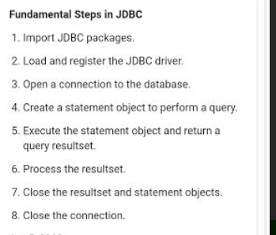
Fundamental Steps in JDBC http://www.informit.com/articles/article.aspx?p=26251&seqNum=3
The fundamental steps involved in the process of connecting to a database and executing a query consist of the following:
Import JDBC packages.
Load and register the JDBC driver.
Open a connection to the database.
Create a statement object to perform a query.
Execute the statement object and return a query resultset.
Process the resultset.
Close the resultset and statement objects.
Close the connection.

